Slide 1

AI Stock Insights
Executive Summary
Project Overview: Develop a user-input based stock analysis tool focused on AI companies, providing stock recommendations based on user-defined risk/return criteria, historical trends, and future price predictions.
.

Slide 2

Executive Summary
Project Overview: Develop comprehensive stock analysis code that provides:
Insights on comparing one or many –
What is the best day of the week to purchase?
What is the cumulative percentage change in price?
Historical trend analysis
Stock Comparison of:
Moving Average, Sharpe Ratio, Volatility, CAGR, RSI, Beta, Max Drawdown, Points

Slide 3

Danny Srour
Read.md file
Visualization
Github Version control
Caleb Kelson
Contributor
Visualization
Ryan Brown
Data Cleaning
Visualization
Cathy Schassberger
Contributor
Presentation
Daniel Liu
Contributor
Visualization
Austin Cappetta
Contributor
Visualization

Slide 4
Project Approach
Our group’s approach to achieving the project goals involved several structured and collaborative steps:
Initial planning and goal setting
Outline the primary objective:
Develop stock analysis code focused on AI companies. This tool would provide analysis so a reader could identify stock recommendations based on historical trends, stock comparison, future price predictions and the best day of the week to make a purchase.
Stock Selection
Six prominent AI-related companies were the focus:
NVIDIA, Amazon, Oracle, Meta Platforms, Alphabet Inc and Tesla. The companies were selected based on their significant impact on the AI industry.
Data Collection
Five years of historical data from November 2019 to November 2024.
Data included prices and relevant financial metrics for the selected companies.
Reliable financial databases were used to ensure the accuracy and completeness of the data.
Data Cleaning
The data was meticulously cleaned to handle missing values, outliers and inconsistencies. This step was
crucial to ensure that our analysis and predictions would be based on high-quality and reliable data.

Slide 5
Data Exploration
Data was explored to understand trends, patterns and relationships. This step involved visualizing the data, performing statistical analyses, and identifying key insights.
User input and interaction design
The tool was designed to be user-friendly, allowing users to input their risk tolerance and desired returns.
The tool provides a list of AI stocks for selection and offers interactive elements to enhance user engagement.
Visualization and reporting
Interactive charts and graphs were created to visualize stock performance and trends.
The visualizations help users make informed decisions by providing clear and comprehensive insights.
Testing and refinement
Thorough testing was conducted to ensure the code’s functionality and accuracy.
Team feedback was gathered and incorporated to refine and improve the code.
Deployment and Future Enhancements
The code was finalized and deployed.
Planning future enhancements were discussed such as integrating additional AI companies, adding prediction algorithms, and incorporating user interaction.
The structured approach ensured that we stayed focused on our goals, collaborated effectively, and delivered a robust Stock analysis code.

Slide 6
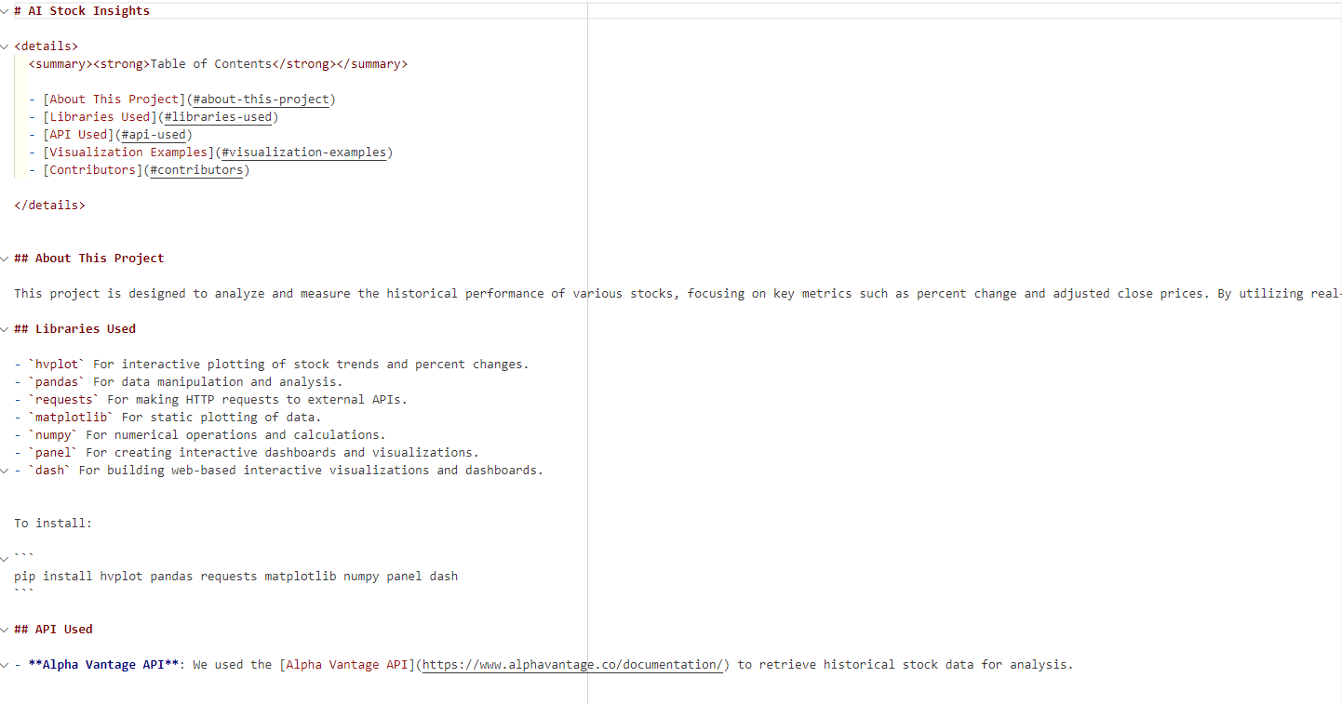
README.MD

Slide 7

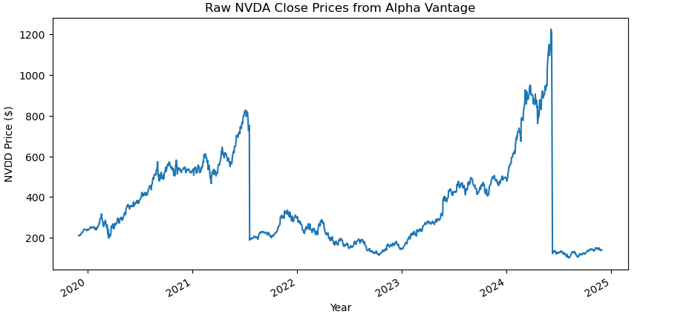
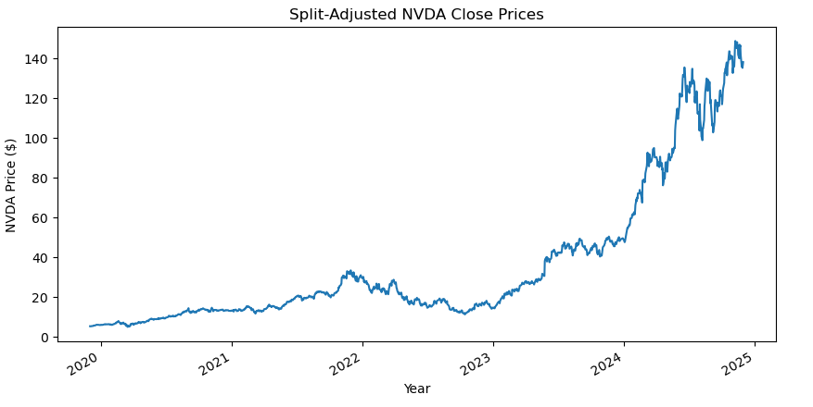
Major Inconsistency: The Stock Split
When pulling the data for the stocks, it was observed that an anomaly had occurred. Upon further investigation, it was determined that some of the stocks had undergone a stock split. When a stock split happens, the total number of shares increases while the price per share decreases proportionally, ensuring the market capitalization remains the same. This corporate action can affect historical price data and the volume, necessitating adjustments to maintain consistency in financial analysis and reporting.
Below is are the graphs illustrating the stock prices before the split and after the split.
Nvidea

Slide 8
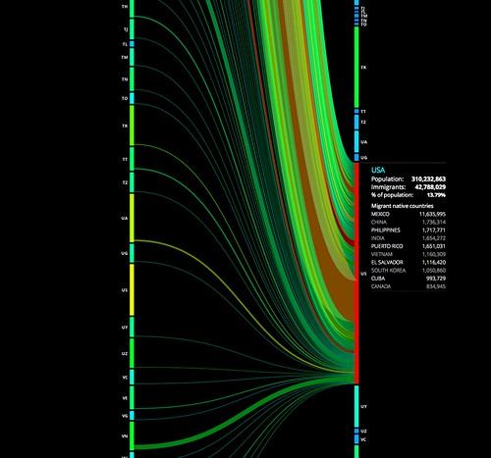
Explorations
and
Visualizations

Slide 9
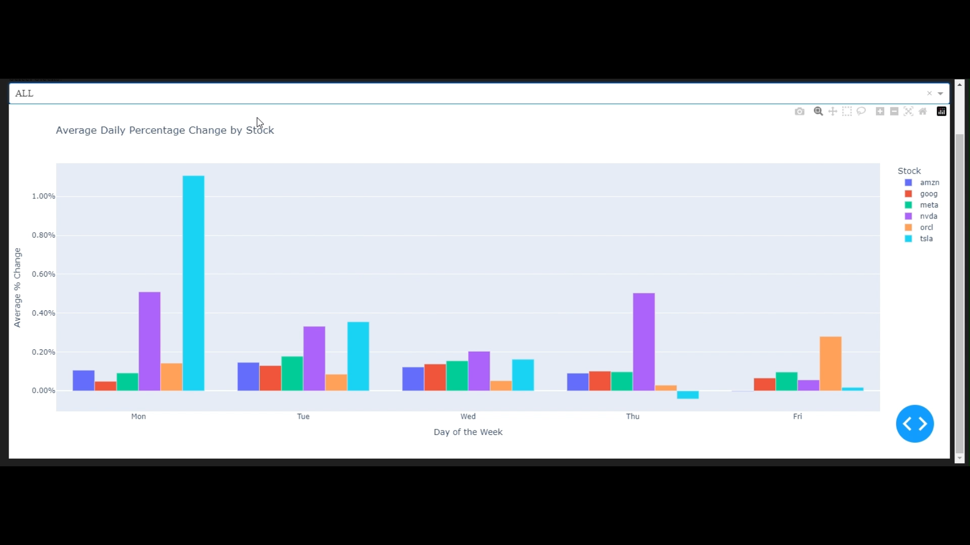
Question 1 – Comparing one or all stocks what is the best day of the week to purchase?

Slide 10
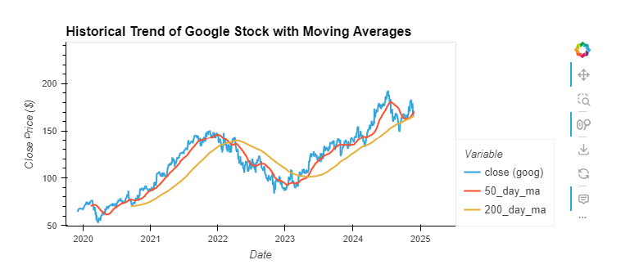
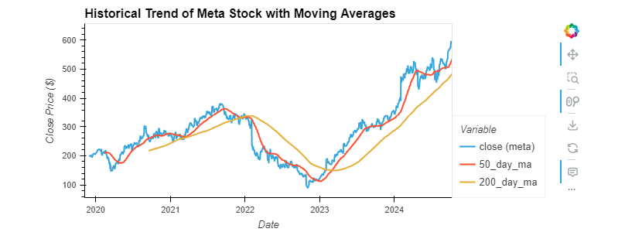
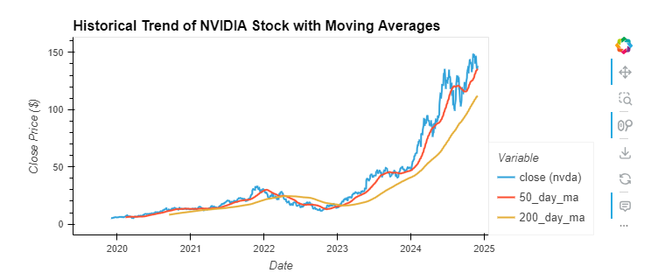
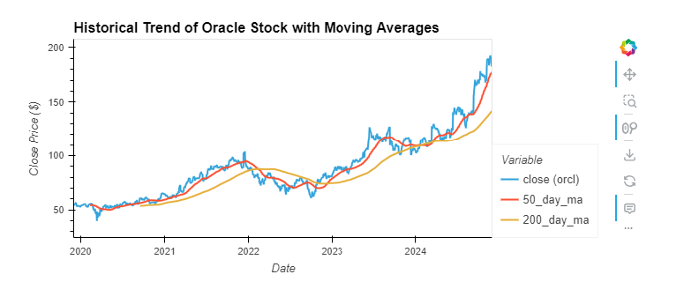
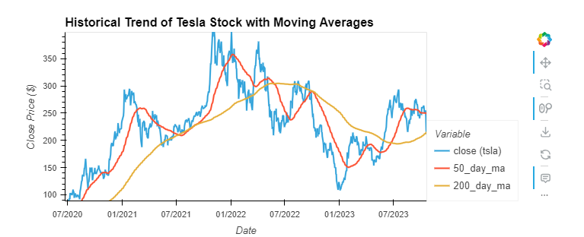
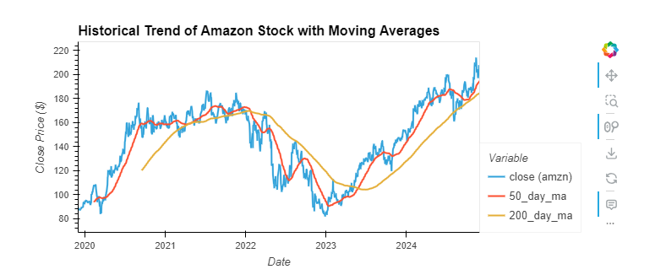
Question 2 – What are the historical trends

Slide 11
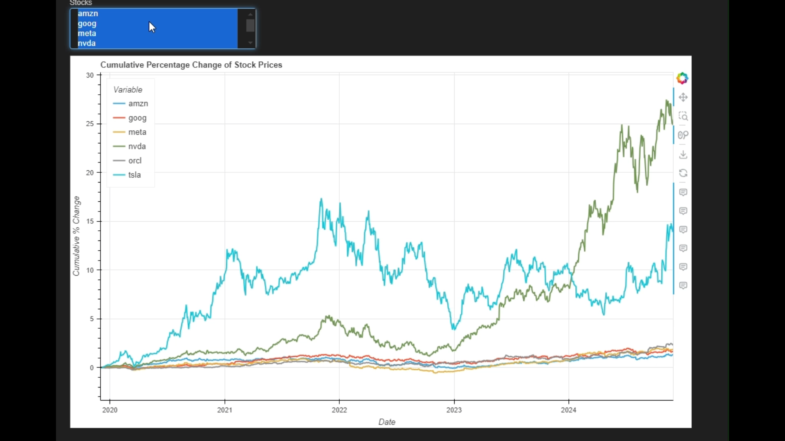
Question 3 – Culminative percentage change?

Slide 12
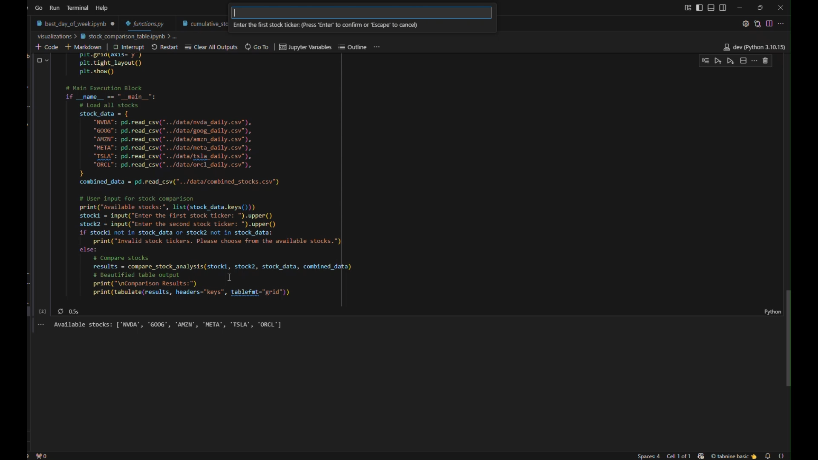
Question 4 – Stock Comparison

Slide 13

Our project offers a comprehensive analysis of six leading AI stocks, examining historical trends in split-adjusted stock prices and providing a detailed comparison. This enables users to make informed decisions about the best times to buy and offers a clear perspective for selecting AI stocks. With additional time and expertise, we aim to enhance this tool by incorporating functionality to analyze any user-specified stock, project potential investment returns, and provide tailored stock recommendations based on individual investment goals and risk preferences

Slide 14

Questions?
https://github.com/srourdanny/stock_analysis.git

